Slide 1
#GiveLife Challenge

Slide 2
Agenda
#GiveLife Challenge
About Canadian Blood Services
The Facts About Blood
The Need
The Donation Process
Stem Cell Donation
The Challenge

Slide 3
About Canadian Blood Services
Notes:
I would like to introduce you to Canadian Blood Services in terms of:
Who we are
What our mission is &
What we do for the community

Slide 4
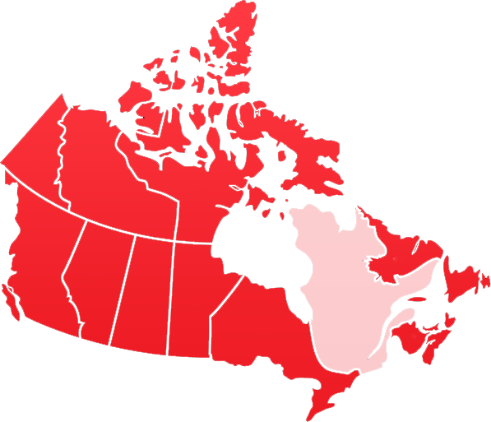
We are a...
National, non-profit organization
Notes:
Canadian Blood Services is a national, not-for-profit charitable organization that manages the supply of blood and blood products in all provinces and territories outside of Quebec. Canadian Blood Services also provides national leadership for organ and tissue donation and transplantation and oversees the public cord blood bank and unrelated stem cell network.
At any given time, close to 1,000 Canadians are waiting for a stem cell match. Stem cells are used to treat more than 80 diseases and disorders including leukemia, lymphoma, aplastic anemia, sickle cell anemia, and inherited immune system and metabolic disorders.
We operate 4 public cord blood banks. Giving mothers a chance to donate their child's cord blood to save lives is such a simple act of love and kindness that can have a big impact on patients searching for a second chance.
Ottawa — at the Ottawa Hospital General and Civic campuses
Brampton (Greater Toronto Area) — at the William Osler Health System’s Brampton Civic Hospital
Edmonton — at the Alberta Health Services’ Lois Hole Hospital for Women
Vancouver — at the BC Women’s Hospital and Health Centre

Slide 5
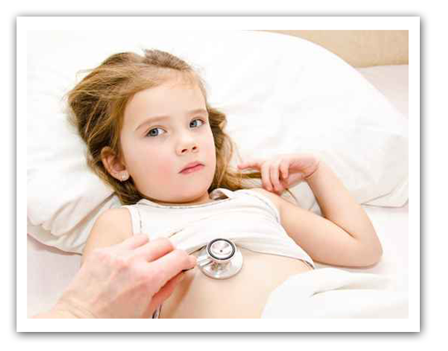
Mission:
To manage a safe, secure and accessible supply of blood and blood products for all Canadians
Notes:
Our mission is to manage a safe, secure and accessible supply of blood and blood products for all Canadians.

Slide 6
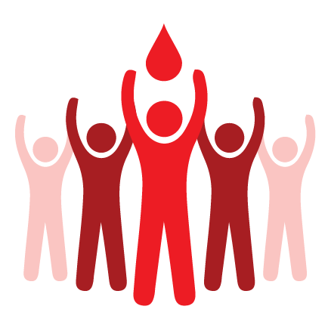

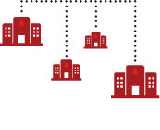
100,000 New Donors Needed
Production, Testing,
Inventory, R&D, Education
439 Hospital
Customers
Over 800,000 units of whole blood donations
32 permanent donation collection sites
14,000 annual clinics
Notes:
We own and operate all aspects of the blood supply: we recruit, collect, test and distribute blood to our hospitals at which point doctors use the blood as transfusion medicine for patients in need.
100,000 new donors are needed this year in order to ensure we meet patient needs.
Canadian Blood Services has over 32 permanent donation collection sites, two blood testing facilities and 10 manufacturing facilities.
Any questions?

Slide 7
Why is this important?

Slide 8
Quick Facts
Every minute in every day, some needs blood or blood products
1 in 2 Canadians can give blood…
but only 1 in 60 do
Only 25% of patients will find a stem-cell donor within their family

Slide 9

Why you should get involved
In 2013, at just 16 years old, Mackenzie was diagnosed with cancer. During her treatment, she received 27 blood transfusions and a lifesaving stem cell transplant. Thanks to the generosity of donors, Mackenzie is enjoying life with her family and friends.

Slide 10
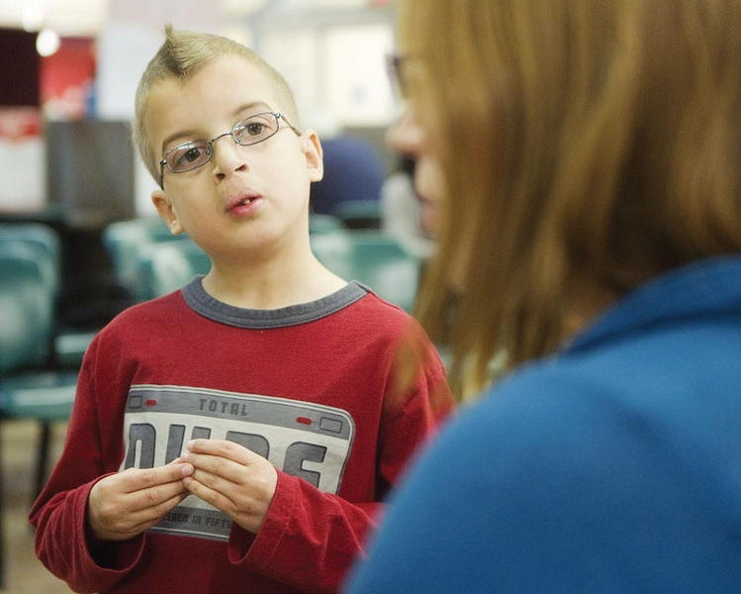
Why should you get involved?
Hunter is now 13 years old. Soon after he was born, he was diagnosed with a rare blood disorder called Diamond Blackfan Anemia. He requires a blood transfusion every 3 weeks and chelation every night for 12 hours. To date he has received over 200 transfusions!

Slide 11
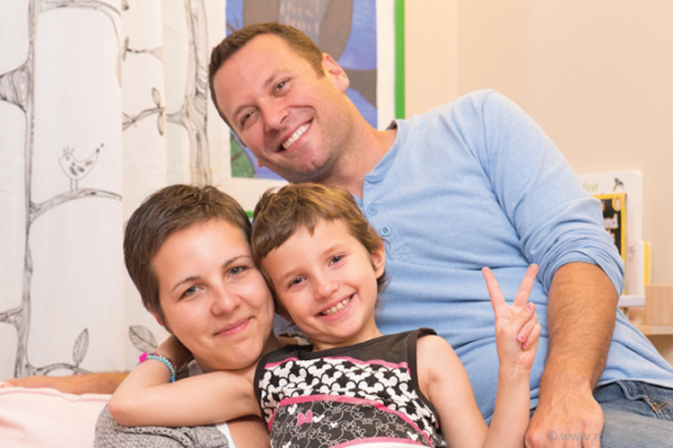
Why should you get involved?
When their daughter Sarah was diagnosed with acute myeloid leukemia, Mark and Leah were told she would need a stem cell transplant to survive. They decided to raise awareness about the need for blood and stem cell donors. Sarah lost her battle but her parents continue to advocate for patients just like her who are in need of blood and stem cells.

Slide 12
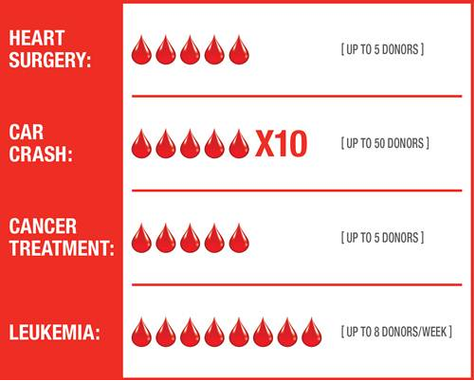
How much blood is needed?

Slide 13
The Facts About Blood
Notes:
Now I’d like to teach you a little bit about blood.

Slide 14
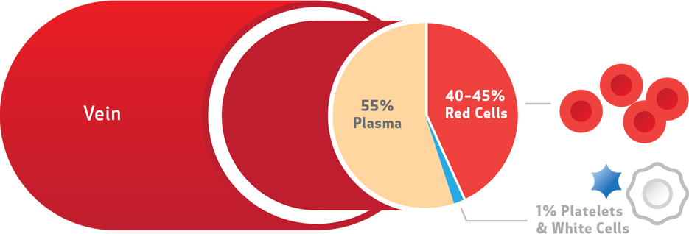
Components of Blood
Notes:
There are four components to blood:
Red blood cells, plasma, platelets, white blood cells

Slide 15
What Does Blood Do?
Transports oxygen and nutrients to our tissues
Carries carbon dioxide and waste products away from tissues
Carries hormones to their target tissues
Plays a role in temperature and fluid regulation
Protects the body from bacteria and foreign substances
Notes:
Blood is a liquid tissue. A tissue is a group of cells similar in origin, that work together to perform a specific function.
Q: Can anyone tell me, what are some of the functions of blood?
A: Transport Oxygen and nutrients to tissues
Carries carbon dioxide and waste products away from tissues
Carries hormones to their target issues
Plays a role in temperature and fluid regulation
Protects the body from bacteria and foreign substances
Blood is essential to sustaining life, and a common factor between all of us!

Slide 16
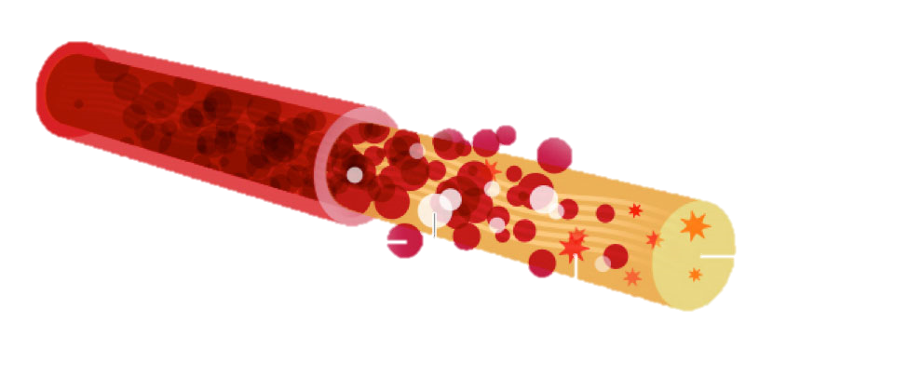
Shelf Life of Blood
Frozen Plasma – 1 Year
Platelets – 5 Days
Red Blood Cells – 42 Days
Notes:
All blood products have a shelf life:
Red blood cells – 42 days
Platelets – 5 Days
Plasma frozen up to 1 year.
Plasma is the liquid that cells are suspended in, containing many of the body's proteins that help fight infection and help clotting. It distributes nutrients to tissues and transports waste products to the lungs, liver and kidneys, which expel them. It is the plasma portion of our blood that helps transport our red blood cells, platelets, and white blood cells throughout our body.
As most donations are used with 5 days, the need for blood is constant.

Slide 17
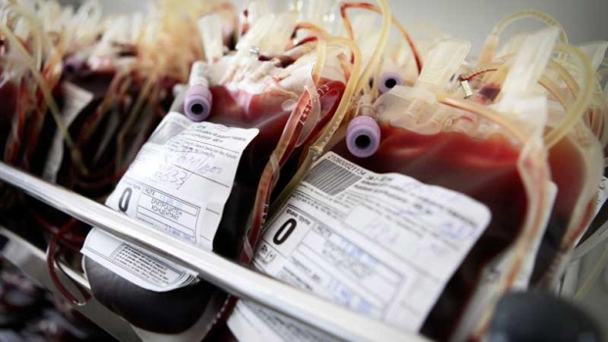
What is a
“Blood Product?”
Notes:
These components are then manufactured into a blood product.
A blood product is any component of the blood which is collected from a donor for use in a blood transfusion. Whole blood is uncommonly used in transfusion medicine at present; most blood products consist of specific processed components such as red blood cells, blood plasma, or platelets.
What can these components be used for?
Red blood cells – can be used to help accident victims, surgical patients and people with anemia.
Plasma – is effective in treating patients suffering from shock and burns.
Platelets – are our smallest cells and help to clot the blood in the event of a broken blood vessel. Platelets can be used to treat leukemia and other cancer patients; people with bleeding disorders.
White Blood Cells are not transfused, as they contain unique antibodies that could be harmful to a sick patient
These components may be transfused separately or together depending on the treatment the patient requires to treat their condition.

Slide 18
Blood Types in Canada
Percentage of Canadians
Notes:
This chart shows you the percentage of blood types among Canadians.
O positive blood is the most common in Canada. AB negative is the most rare.
O – which represents only 7% of the Canadian population is the blood type that is the highest in demand because it is compatible with all blood groups and is used in emergency situations – when seconds count!
AB – is the rarest blood type representing .5% of the Canadian population. AB – blood type can receive blood from all negative blood types.
However, all blood types are needed.

Slide 19
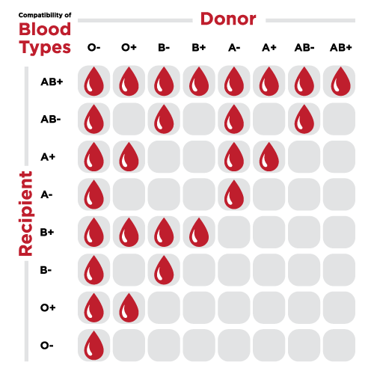
Blood Compatibility
Notes:
Not only does blood have a shelf life – not all blood groups are compatible with each other.
As you can see from this chart:
O- universal donor
AB + universal recipient

Slide 20
You help give someone moments that matter most

Slide 21
How Donation
Works

Slide 22
The Give Life Process
You must be at least 17 years of age and in good health to begin
Step 1:
Help Station
Step 2:
Questionnaire
New donor registry
Photo identification needed
Donor Card?
Q-Pass?
Donor card scan
Complete eligibility questionnaire on a tablet
Read pamphlet:
“What you must know to give blood”
Notes:
Donating blood is easier than you’d think. To donate, you must be 17 years of age, in general good health, and feeling well on the day of your donation. It’s important to have had a good meal before your appointment, and to stay well hydrated by drinking lots of fluids 1-2 days prior.
There are four steps to the process:
Step 1 is the Help Station - You will need to provide identification with a full name and signature, or a full name and photograph, such as a valid driver’s license. If this is your first donation, you will go to the help station where they will provide you with a temporary donor card. You will receive your printed donor card in a few weeks following your donation.
If you already have a donor card, you can skip this step and move on.
We also have a new feature called a Q-Pass which allows you to skip steps one and two, but we’ll get to that in a minute.
Step 2 is the Donor Questionnaire – Once you have your donor card in hand, we will scan it and you can begin your electronic questionnaire. It can be completed quickly on a tablet on-site. It’s designed to determine if it is safe for you to donate blood.
You will also be asked to read a pamphlet called “What You Must Know,” which provides general information on high risk activities, donating blood, and what happens after you donate.
If you already have your donor card, your email address in our system and an appointment pre-booked under your name, you can fill out this questionnaire online prior to your clinic visit! This will get you a Q-Pass.

Slide 23
The Donation Process
Step 3:
Screening
Step 4:
Donation
Q-Pass (available after first donation)
Review of donor questionnaire
Hemoglobin and vitals will be checked
Takes 5-20 minutes
Approximately 500ml of blood
Notes:
Step 3 is the Screening Process.
If you have a Q-pass you can start your give life process here and skip the line! As the Q-Pass is a barcode generated after completion of the questionnaire, please ensure you have printed it out or saved it as a PDF on your cell phone, as it needs to be scanned.
We will be able to determine eligibility based on your responses to the questionnaire and during a quick private interview.
At this step, we will check your hemoglobin levels, blood pressure and other vital signs.
Donor safety is paramount. You must pass all screening criteria in order to donate blood. If any of the test results or interview answers indicate you are not eligible to donate, the Canadian Blood Services employee will explain why you are not able to donate. This information is disclosed only to you, and remains confidential.
Even if you find yourself ineligible to donate, your involvement doesn’t have to end here. You can recruit your friends and family members who may be able to instead.
Step 4 involves the actual Donation:
If you pass all screening criteria, you will be taken to a separate area for your donation.
Donating blood does not put you at risk for disease. We use a new, sterile needle every time, which is safely disposed of afterwards.
The usual amount of blood that we collect is about half a litre, or approximately 2 cups.

Slide 24

The Donation Process
Step 5:
Relax & Refresh
Refreshment area
Free cool drink and
sweet snacks!
Book your next appointment (if you haven’t done so already)
Notes:
The final step is the easiest – JUST RELAX!:
Following your donation, you will be greeted by one of our friendly volunteers in our hospitality area, where we will make sure you have some time to rest, in case you may have any adverse reactions to donating blood – for example, some people may feel a little light-headed, particularly following a first donation.
Here, you can refuel with an unlimited supply of delicious cookies, juice and other beverages; all of which will help boost your blood sugar level.
Your body soon replaces all the blood you donate; plasma replenishes itself within hours and completely within 48 hours, platelets within a few days and red blood cells within 56 days.
There is a 56-day waiting period in-between whole blood donations for men and an 84 day waiting period for women.
You can also book your next appointment to Give Life if you haven’t done so already.

Slide 25
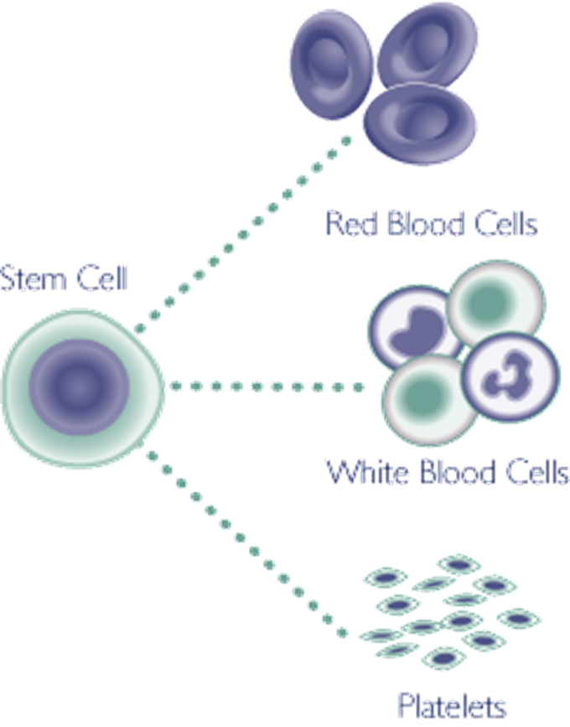
Stem Cells?
What are…
Immature cells
Divide and develop into any one of three main types of cells found in blood
Sources: peripheral (circulating) blood, cord blood, bone marrow
Notes:
What are Hematopoetic Stem Cells (HSC)?
Stem cells are immature cells (undifferentiated) that can develop into any cell present in the bloodstream: red blood cells, white blood cells, platelets and other blood components.
Blood stem cells are not embryonic stem cells. They come from bone marrow, circulating (peripheral) blood or umbilical cord blood. People whose diseases inhibit their ability to produce these kinds of cells need a transplant of healthy stem cells from a donor.
Donors may be asked to donate either peripheral blood stem cells or bone marrow depending on the physician’s choice of therapy for the patient. After donating, most donors are back to their usual routine in a few days.
Let’s take a closer look at three sources of stem cells:
Circulating (peripheral) blood – Stem cells in your circulating blood (peripheral blood) are collected using a non surgical procedure called apheresis.
Bone Marrow
Cord Blood

Slide 26
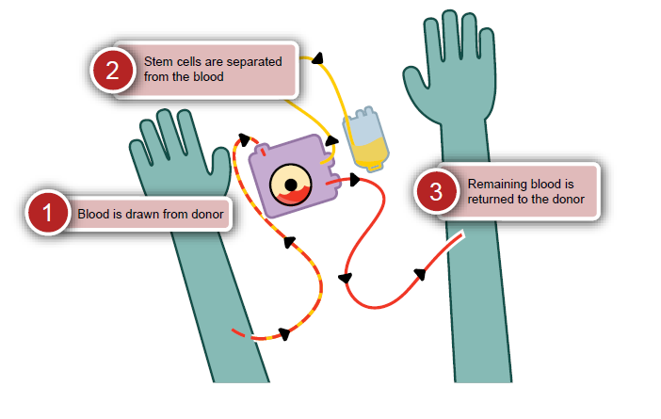
Peripheral Blood
Collection Methods
Notes:
Peripheral stem cells are collected from circulating (peripheral) blood. Because only a small number of stem cells is released into the blood stream, a cell growth stimulating drug is administered to donors prior to the donation to dramatically increase the volume of stem cells in the blood for collection and transplant. Your blood is drawn through a needle in a non-surgical procedure done at the hospital. After the stem cells are separated from the blood, the rest is returned back to your body through another needle.

Slide 27
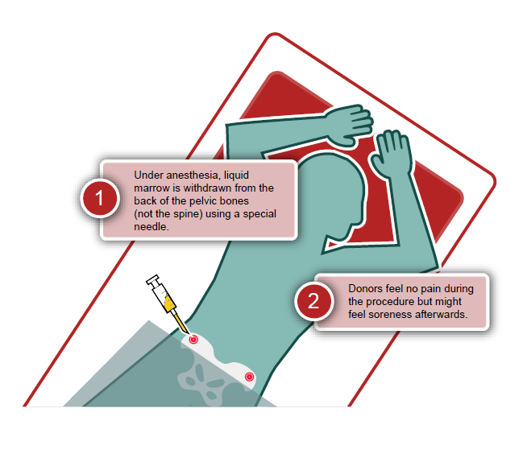
Bone Marrow
Collection Methods
Notes:
Bone marrow is the soft, jelly-like tissue found in the hollow center of bones. It is like a factory that produces stem cells, which are the building blocks of blood. Bone marrow donors undergo a surgical procedure where the marrow containing the stem cells is collected from the pelvic bones.
Many donors are released from the hospital the same day they undergo the collection. Some need several days off work and avoid strenuous activity for at least two to three weeks, which is approximately how long it takes to regenerate the donated marrow.
Bone marrow is taken from the back of the hip bones, not the spine and is performed with anesthesia.
Normally about a liter of fluid is taken. This procedure usually lasts from 45-90 minutes. The collection includes blood along with the stem cells from the bone marrow. Total volume can range from under .5 liters to as much as 1.5 liters depending on donor size and recipient size. Both blood and stem cells are replenished with six weeks.

Slide 28
How do I know if I am able to donate?

Slide 29
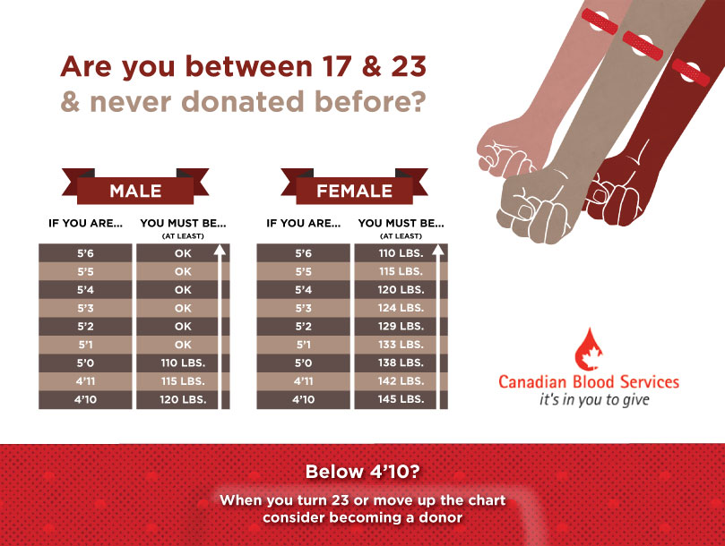
Can I donate?
TAKE THE QUIZ!
Notes:
You have to be 17 or older to date. Basic information regarding eligibility can be found at the Eligibility quiz link above. Please visit our website, email at feedback@blood.ca or CALL 1 888 2 DONATE or 1 888 236 6283. We are here to support you!
Click the “TAKE THE QUIZ” link to go to the quiz website.

Slide 30

Who Can Register to Donate
Stem Cells?
17-35 years old
Generally healthy
Willing to donate to any patient in need
Register at blood.ca to receive your self-swab kit
Notes:
Right now we have a special need for ethnic and Aboriginal males aged 17 to 35.
You may be eligible to join if you are between 17 and 35 years old and meet certain health criteria, and if you are willing to be a match for non-relative patients. Because a person's best chance of finding a matching donor is within his or her own ethnic group, it is important that donors reflect Canada's ethnic diversity.

Slide 31
Getting Started

Slide 32
How to Succeed…
Quick Tips
PLAN:
Form a team
Work with your teachers and school
Brainstorm ideas
PROMOTE:
Spread the word
Get friends and family to register online
Have fun and save lives!
Notes:
Here are some tips on how to win that prize money:
PLAN:
Form a team – divide responsibilities
Work closely with your teacher organization and school administration and ask for their guidance of how to best spread the word – on the schools intranet, or student portals, ask teachers for their support in helping to recruit donors.
Schedule meetings on regular basis to check to see how things are going.
PROMOTE:
Create excitement – it’s about helping a hospital patient in need of your support by donating blood
Promote the event – promotional posters, eligibility criteria, height and weight chart, teacher information sheet -- Territory Managers can provide you with all of these materials to help you raise awareness about the upcoming event
Schedule morning announcements – get creative, update with stats and progress
Share videos from our Youtube channel on social media
Create your own school video
Schedule senior classroom visits
Schedule a “What’s Your Type” event during lunch hour to educate and help raise awareness for the need of blood donors
Book a senior assembly - work with your CBS representative – potential for recipient speaker
Peer to Peer Recruitment is one of the most effective ways to recruit donors. Many people have not considered donating blood because they were not asked and did not know that they were needed.
Q: Now it is time to break out into smaller groups and brainstorming recruitment ideas:
Ideas to help spice up your clinic:
Beat last year’s donation record
“In Honour” Program
Pizza party for winning homeroom
Challenge local schools – Post your activities on facebook, tweet, instagram

Slide 33




Let’s Get Social!
#GiveLife
@itsinyoutogive
#GiveLifeChallenge
Notes:
Download our free GiveBlood App
Like us on Facebook/canadianbloodservices
Follow us on twitter @itsinyoutogive
Use the hashtags #GiveLifeChallnege & #GiveLife
Instagram / @itsinyoutogive #GiveLife # YoungBloodForLife

Slide 34
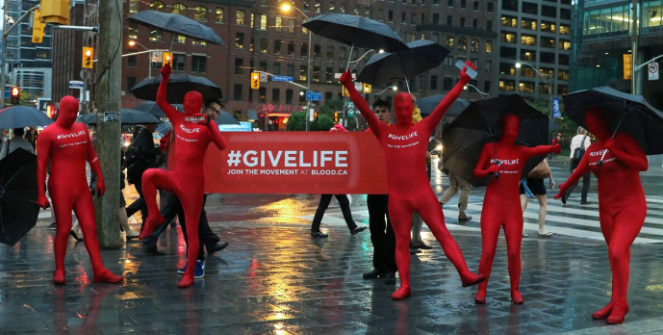
Let’s #GiveLife

